Slide 1
DATA ANALYSIS REPORT
Bright Car Sales
Market Insights
548,400 transactions • 96 brands • Jan 2014 – Jul 2015
Prepared by Blessings Ronald Mwamuka
Email :blessingsmwamuka@gmail.com

Slide 2
EXECUTIVE SUMMARY
Key Metrics at a Glance
548.4K
$7.51B
$13,689
96
Total Vehicles Sold
Total Revenue
Average Selling Price
Brands Represented
What stands out
• Ford leads the market with 93,553 vehicles sold (17% of all transactions).
• Automatic transmission dominates at 96.4% of sales — manuals are a niche segment.
• Median price ($12,200) sits just below the average — pricing is fairly symmetric with luxury tail.
• Sales activity spans Jan 2014 – Jul 2015 across 973 distinct models.
Used Car Sales Analysis • 2014–2015
2

Slide 3
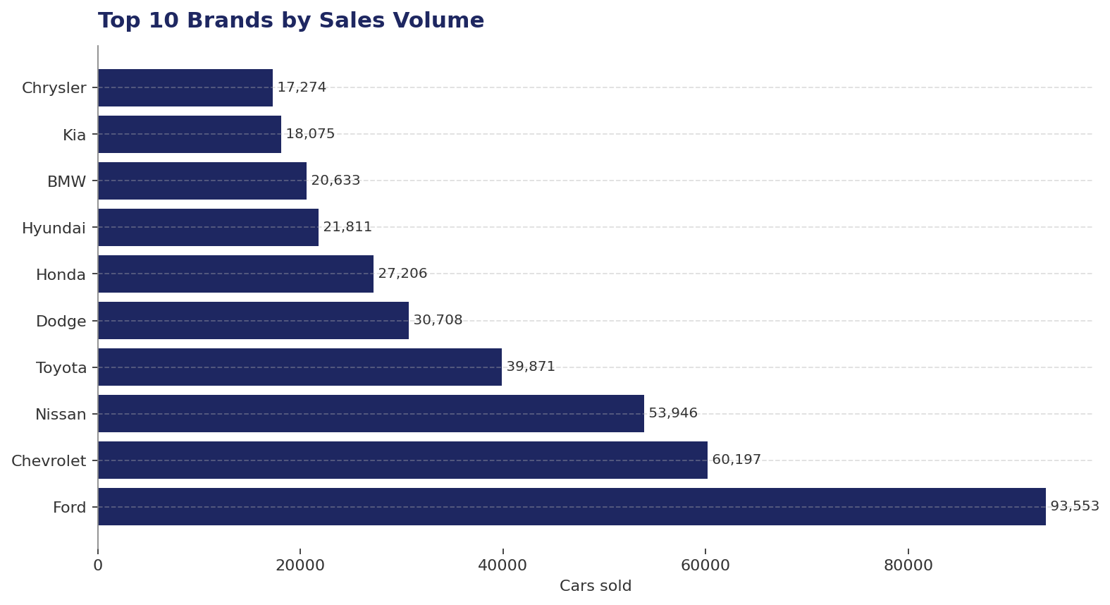
BRAND PERFORMANCE
Top 10 Brands by Sales Volume
INSIGHT
Ford leads — but the top 4 own the market
Ford, Chevrolet, Nissan, and Toyota account for the bulk of transactions. Inventory and pricing strategy should prioritize these high-volume brands. The long tail of 90+ smaller brands offers niche margin opportunities.
Used Car Sales Analysis • 2014–2015
3

Slide 4
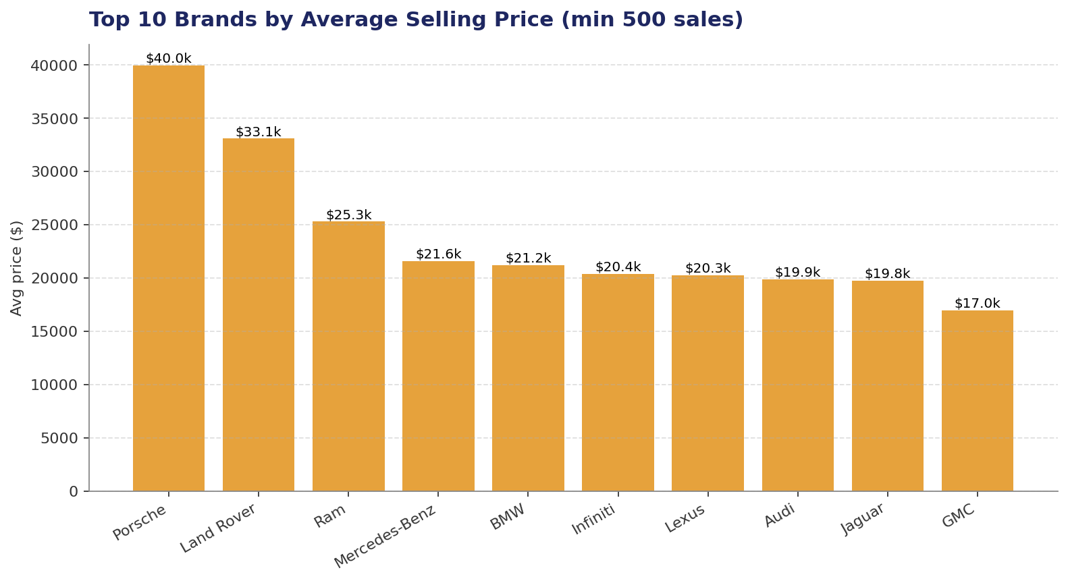
PRICING
Average Selling Price by Brand
INSIGHT
Volume ≠ value
High-volume brands aren't the highest-priced. Premium marques sustain significantly higher average prices despite lower volume — a clear segmentation between volume players and luxury segments.
Used Car Sales Analysis • 2014–2015
4

Slide 5
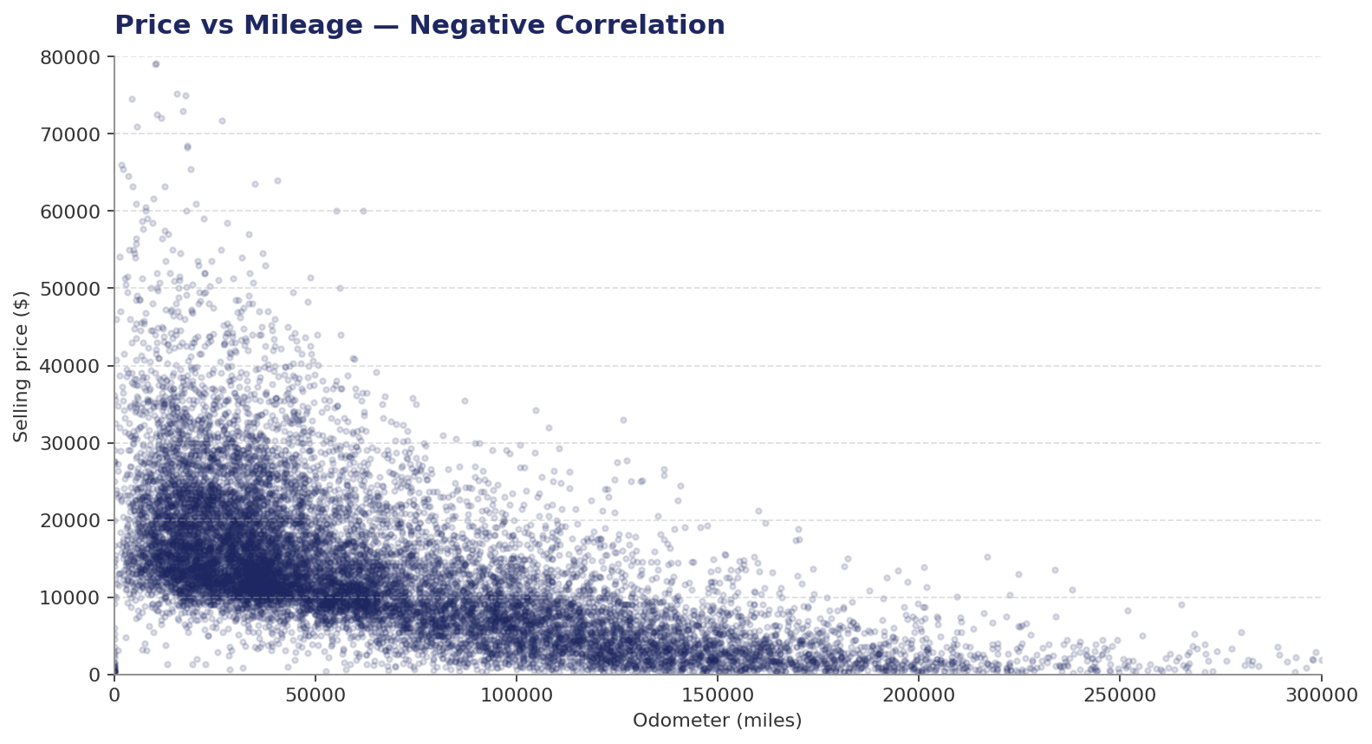
PRICING DRIVERS
Price vs Mileage
INSIGHT
Mileage drives depreciation
Strong negative relationship between odometer reading and selling price. Cars under 50K miles command premium prices; beyond 150K, prices flatten near the floor. Use mileage bands for pricing models and trade-in valuations.
Used Car Sales Analysis • 2014–2015
5

Slide 6
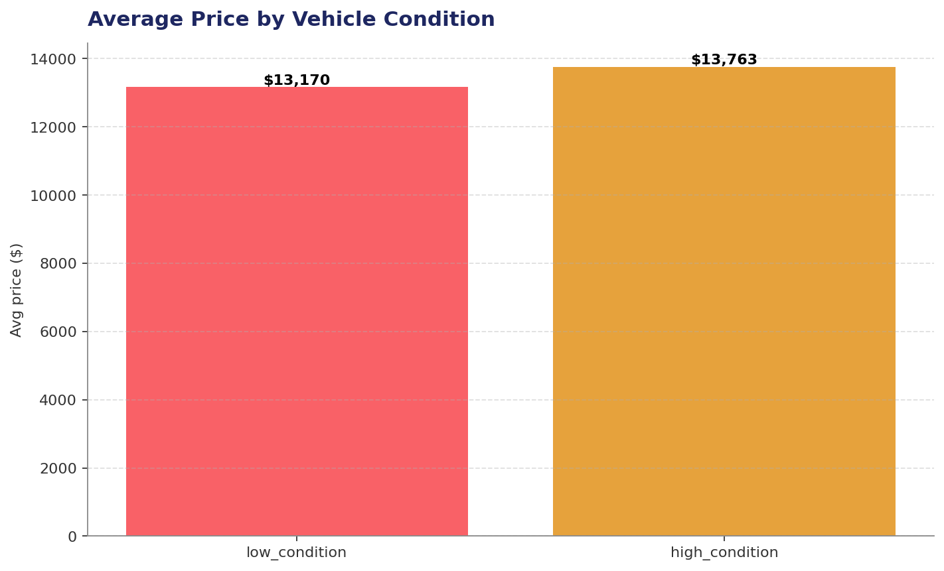
QUALITY
Average Price by Vehicle Condition
INSIGHT
Condition matters — but less than expected
High-condition vehicles average $13,763 vs $13,170 for low-condition — only ~4.5% premium. This suggests buyers may not be paying enough for condition, or that other factors (brand, mileage, year) dominate price formation.
Used Car Sales Analysis • 2014–2015
6

Slide 7
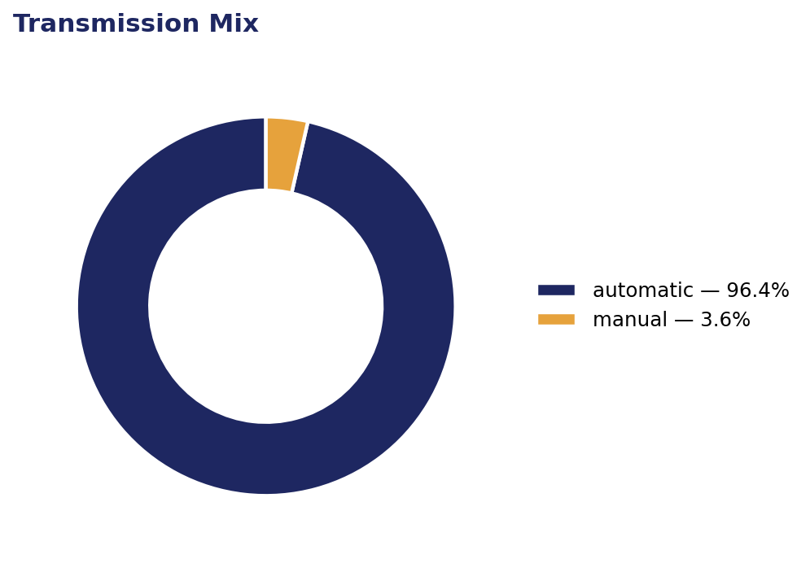
MIX
Transmission Share
INSIGHT
Automatic dominates at 96%
Manual transmissions are a small minority. Stocking decisions should heavily favor automatics, with limited manual inventory targeting enthusiast segments.
Used Car Sales Analysis • 2014–2015
7

Slide 8
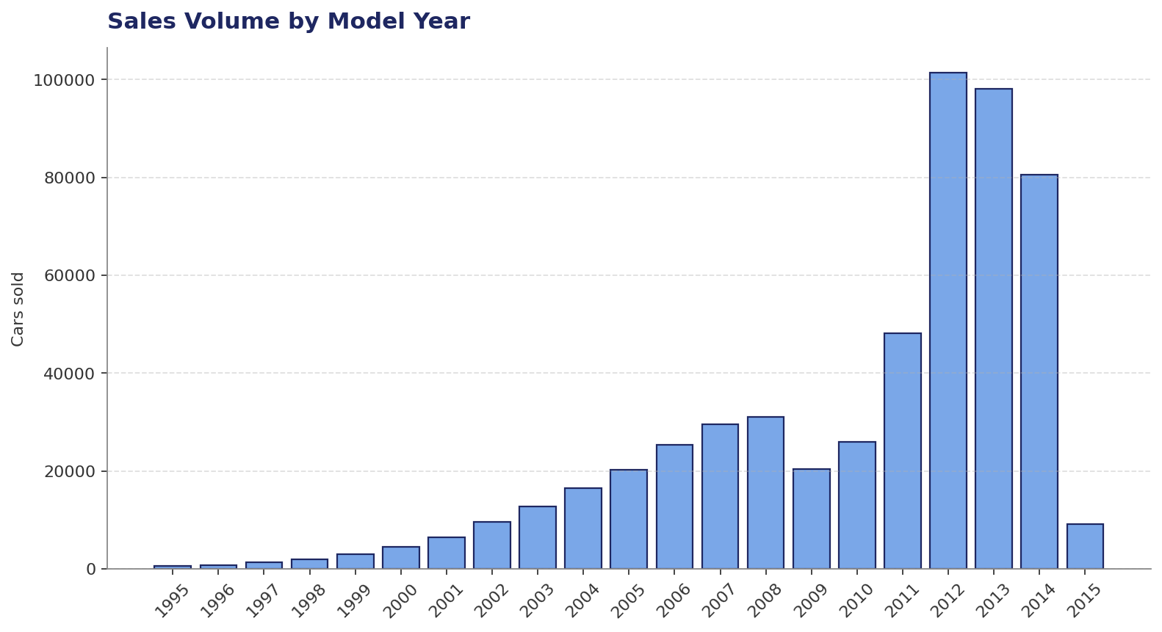
INVENTORY AGE
Sales Volume by Model Year
INSIGHT
Sweet spot: 3–5 year-old vehicles
Sales concentrate around recent model years (2012–2014), reflecting typical lease return and trade-in cycles. Older inventory (pre-2005) sees thin demand and should be discounted aggressively.
Used Car Sales Analysis • 2014–2015
8

Slide 9
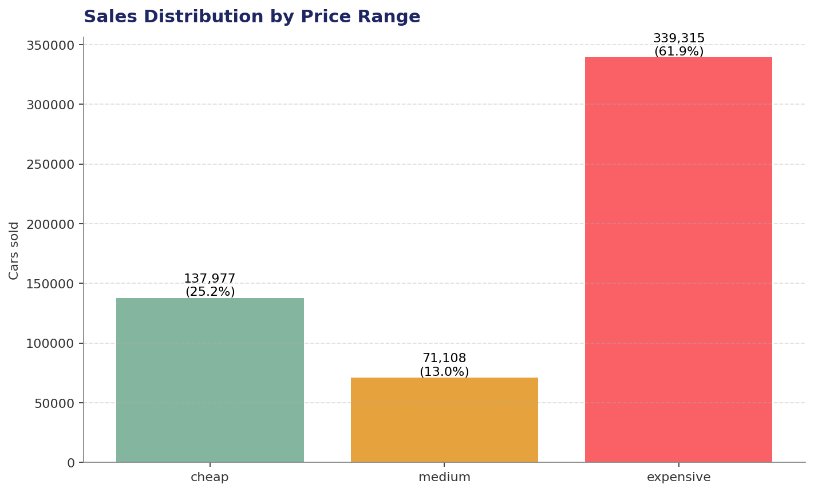
SEGMENTATION
Sales by Price Range
INSIGHT
Mid-market is the sweet spot
The medium price band leads sales volume, with the cheap and expensive segments behind. Marketing and inventory should align with mid-market buyer demand while preserving margin in the expensive tier.
Used Car Sales Analysis • 2014–2015
9

Slide 10
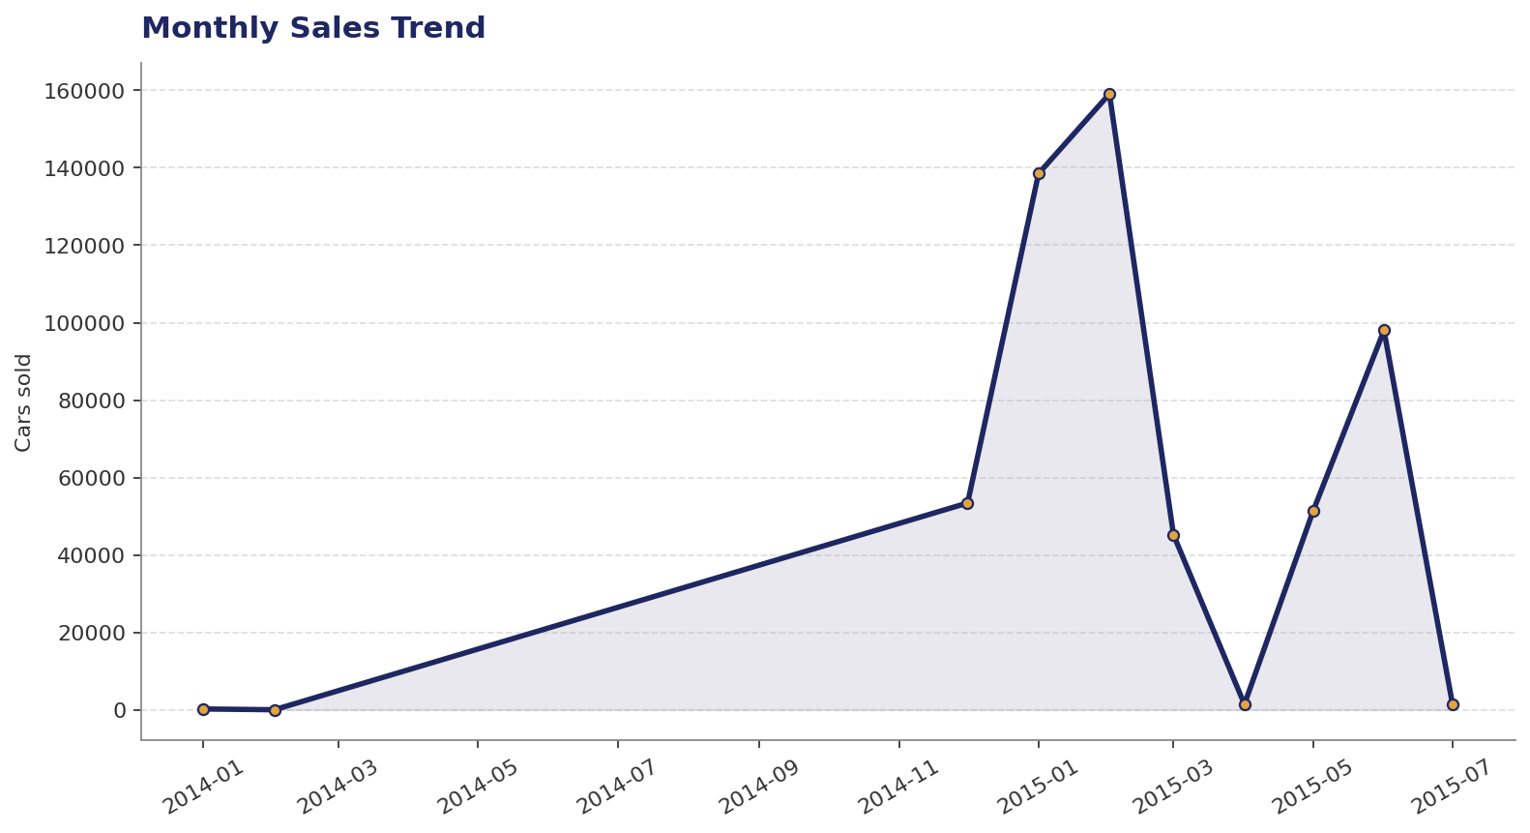
TREND
Monthly Sales Trend
INSIGHT
Steady volume with seasonal swings
Monthly sales fluctuate within a stable band across 2014–2015. Watch for early-year peaks and mid-summer softness when planning campaigns and staffing.
Used Car Sales Analysis • 2014–2015
10

Slide 11
RECOMMENDATIONS
What to do next
1
Optimize inventory mix
Prioritize Ford, Chevrolet, Nissan, Toyota — and skew automatic transmissions (85% of demand).
2
Build a mileage-tiered pricing model
Use the strong price-vs-mileage relationship to standardize trade-in valuations and listing prices.
3
Re-examine condition pricing
Only ~4.5% spread between low and high condition — there may be room to charge more for high-condition stock.
4
Focus on 3–5 year-old vehicles
Sweet spot of buyer demand — align procurement with this age band and discount older stock faster.
5
Segment marketing by price band
Tailor campaigns: value seekers (cheap), family buyers (medium), enthusiasts/luxury (expensive).
Used Car Sales Analysis • 2014–2015
11

Slide 12
Thank you
Questions & discussion

